Slide 1

Measuring Christian Privilege: A Two-Factor Scale
Thesis Defense Meeting

Slide 2
A Brief Literature Review

Slide 3
First off, what is privilege?
Per Israel (2012, p. 158), privilege can be defined as the “unearned advantages that are conferred to individuals based on membership or assumed membership in a dominant group”
Groups that have been theorized to confer privilege include Whites, Male, Middle Class, and Christian (McIntosh, 2008; Liu, Pickett & Ivey, 2007; Schlosser, 2004)
However, to this end, much of the literature regarding privilege has mostly been allocated to research regarding White privilege (Pinterits et al, 2009)

Slide 4
White Privilege & Examples (McIntosh, 2015)
Unearned benefits given to people who are classified as White (McIntosh, 2008)
“I can be sure that if I need legal or medical help, my race will not work against me."
“If a traffic cop pulls me over or if the IRS audits my tax return, I can be sure I haven’t been singled out because of my race.”
“I can swear, or dress in second-hand clothes, or not answer letters, without having people attribute these choices to the bad morals, the poverty, or the illiteracy of my race.”
“When I am told about our national heritage or about ‘civilization,’ I am shown that people of my color made it what it is.”

Slide 5
Critical Race Theory
Critical Race Theory
Racism is so embedded, it’s difficult to distinguish from the everyday
Insists what is “normal” should not be equated with “White” (Taylor, 1989)
Historical inequalities still play out in modern times (Taylor, 1989)

Slide 6
Initial Attempts to Measure White Privilege
CoBRAS (Neville, et. al, 2000)
Color Blind Racial Attitudes Scale
POI (Hayes, 2007)
Privilege and Oppression Inventory
WPAS (Pinterits, Poteat & Spainerman, 2009)
White Privilege Attitudes Scale

Slide 7
Reactions To Exposure to White Privilege
Denial of Privilege (Ancis & Szymanski, 2001)
Anger and Guilt (Ancis & Szymanski, 2001)
Lack of Awareness

Slide 8
White Privilege: A Blueprint for Christian Privilege
White people get racial privilege from the founding principles of the United States, which are based upon the following assumptions:
The belief that enslaved Africans and Native Americans are not fully human and should be treated as chattel.
The belief that White Europeans deserve more rights and privileges in US society than non-White’s in this country (Liu, 2007)
The philosophies of manifest destiny and White supremacy (History Editors, 2019)
i.e., manifest destiny is the assumption that God ordained that White settlers should conquer the “New World.”
Notes:
Manifest destiny: https://www.history.com/topics/westward-expansion/manifest-destiny

Slide 9
White Privilege: A Blueprint for Christian Privilege
White people get racial privilege from the founding principles of the United States, which are based upon the following assumptions:
The Bible supported the practice of slavery. For example (Zauzmer, 2019):
Slavery was seen as a Godly means for Africans to be exposed to the Gospel
Some interpretations of the Bible suggestAfricans were descendants of Ham and so they deserved to be slaves
Notes:
“Some theologians said it was providence that had brought Africans to America as slaves, since their enslavement would allow them to encounter the Christian message and thus their eternal souls would be saved, said Mark Noll, a historian of American Christianity.” Source: https://www.washingtonpost.com/local/the-bible-was-used-to-justify-slavery-then-africans-made-it-their-path-to-freedom/2019/04/29/34699e8e-6512-11e9-82ba-fcfeff232e8f_story.html

Slide 10
White Privilege: A Blueprint for Christian Privilege
White privilege gives us a societal template from which we can readily extrapolate the workings of Christian privilege in this country.
In fact, some have postulated that White Privilege and Christian privilege are mutually self-reinforcing (Sutton, 2010)
Others suggest these two privileges share the same fundamental denial processes (Faber, 2012)

Slide 11
Mechanisms of Christian Privilege
The same institutions the privilege Whiteness over other racial groups can be said to privilege Christianity over other religions in the US.
Examples of Christianity being given privileged status can be seen in all of the following major social institutions:
Presidential
Legislative (i.e., Congress)
Judicial (i.e., Supreme Court)
Cultural (i.e., Society)

Slide 12
Manifestations of Christian Privilege
Overrepresentation of Christians in all 3 branches of government relative to population in the US
Population: 70%
Congress: 85%
SCOTUS: 92%
Presidency: 95%
Aphorism “In God We Trust” is on our money and displayed in public schools and on government buildings
Religious Freedom Laws
Allows denial of services based on “deeply held” religious beliefs

Slide 13
Examples of Christian Privilege
Schlosser (2003):
As observed with White privilege, many Christians appear to ignore or are oblivious to the religious oppression of non-Christians and others.
The ability to express your faith without fear that you will be discriminated against based upon such beliefs is another privilege.
Christian values are often explicitly incorporated into federal and state laws and policies.
There is a relative lack of hate groups targeting Christians

Slide 14
Present Study Goals

Slide 15
Present Study Goals
Creation of a scale to assess Christians’ awareness of Christian privilege
Items will be based on the ideas highlighted by Schlosser (2003) in conjunction with thematically relevant or analogous items adapted from Pinterits, et al. (2009) and Neville, et al. (2000).

Slide 16
Why Should We Measure Christian Privilege?
To better fulfill our ideals of living a truly fair society
i.e., privilege can only exist in systems where some have it and others do not
To have a more accurate and objective view of reality
A lack of awareness of privilege prevents one from seeing how advantages influence societal outcomes

Slide 17
Why Should We Measure Christian Privilege?
Very little work has been done on Christian Privilege, and it is important to begin to fill this gap in our knowledge. With such knowledge, we can answer questions such as:
What impact does privilege have on society?
How does awareness impact our ability to understand the plights of others

Slide 18
Why Should We Measure Christian Privilege?
This research will begin to allow us to assess if different forms of privilege (e.g., White privilege vs. Christian privilege) are equivalent, or if they uniquely predict different outcomes.
This research will also allow us to begin to explore the validity of the idea that Christianity and racism are inextricably linked in the United States.

Slide 19
How Is It Different From The POI Christian Privilege Sub-Scale?
More specific from a content perspective with shared themes in the POI-CP
Society is based on Christian views (1)
Christians have religious advantage (5)
Christianity is the norm (8)
Having a theoretical understanding of privilege without being able to recognize concrete examples of said privilege is one of the ways the new scale attempts to differentiate itself (and builds upon) the POI.

Slide 20
Methods

Slide 21
Study Procedures
Christian participants will be recruited to take part in a study
Asked to read a consent form
Fills out various relevant measures (including proposed scale)
Reads a debrief
Gets compensated for their time should they pass study screening questions and attention checks

Slide 22
Participants
Recruitment (N = 389)
SONA (n = 10; ~ 3%)
Reddit (n = 319; ~82%)
Facebook (n = 59; ~15%)
Twitter (n = 1)

Slide 23
Participants
Gender
Male (n = 248; ~64%)
Female (n = 122; ~31%)
Trans-Male (n = 4; ~1%)
Trans-Female (n = 2; ~ .5%)
Non-Binary/Queer/Trans (n = 6; ~1.5%)
Prefer Not To Answer (n = 3; ~1%)
Other (n = 3; ~1%)
Did Not Answer (n = 1)

Slide 24
Participants
Christian Denomination:
Protestant (n = 166; ~42%)
Evangelical (n = 71; ~18%)
Catholic (n = 62; ~16%)
“Other” Christian (n = 90; ~23%)

Slide 25
Participants
Racial Identity
Caucasian/White (n = 287; ~74%)
African-American/Black (n = 14; ~4%)
Hispanics/Latino (n = 28; ~7%)
Other (n = 17; ~4%)
Multiracial (n = 43; ~11%)
Notes:
Check multiracial

Slide 26
Study Measures

Slide 27
Proposed: Christian Privilege Awareness Scale
The scale consists of 28 preliminary items
15 forward scored
13 reverse scored
Items scored on a 11-item Likert scale
Very Strongly Disagree (1) → Very Strongly Agree (11)
Higher scores will indicate a greater level of Christian privilege awareness while lower scores will indicate a lower level of Christian privilege awareness

Slide 28
Relevant Measures
Color Blind Racial Attitudes Scale (Neville, et al., 2000)
20-item 3 factor scale (α = .91)
Higher scores indicate greater endorsement of color-blind ideology
Privilege and Oppression Inventory: White Privilege Subscale (Hayes, 2007)
Assesses awareness of “racial advantage, power, and access” (p. 71)
Higher scores indicate greater awareness
MCC Training population =/= General Public

Slide 29
Relevant Measures
Social Dominance Orientation (Pratto, 1994)
14-item single factor scale (α = .83)
Assesses the degree to which “some people are inherently superior or inferior to others and [their] approval of unequal group relationships” (Pratto, et al., 1994, p. 745)
Higher scores indicate greater agreement with the idea that some are inherently superior or inferior to others
Religious Fundamentalism Scale (Altemeyer & Bruce Hunsberger, 2004)
12-item single factor scale ( = .91)
Looks to measure how infallible people view their religious beliefs
Higher scores indicate higher levels of religious fundamentalism

Slide 30
Relevant Measures
Global Just World Beliefs Scale (Lipkus, 1991)
7-item single factor scale (α = .83)
Looks to measure “the general belief that people get what they deserve and deserve what they get.” (Lipkus, 1991, p. 1172)
Higher scores indicate greater belief that people do indeed get what they deserve and deserve what they get
Sanctification for Social Justice Scale (Todd et. al., 2015)
5-item single factor scale (α = .82)
Looks to measure “how strongly individuals connect working for social justice to an expression of God’s will and what it means to be Christian” (Todd, et al., 2015, p. 245)
Higher scores indicate a perceived stronger connection to working for social justice being an expression of God’s will and what it means to be Christian

Slide 31
Relevant Measures
Privilege and Oppression Inventory: Christian Privilege Subscale (Hayes, 2007)
8 items (α = .86)
Assesses the degree to which people are aware of “the positive portrayal of Christianity in history and contemporary times” (p. 71)
Higher scores indicate greater awareness

Slide 32
Results

Slide 33
Data Analysis Plan
Only cases meeting the following criteria were retained:
Correctly answer 5 (of 8) attention checks
Correctly indicate an eggplant
In the case of double IP addresses, only the earliest response was retained
R and R Studio were used to conduct analyses
The following supplemental packages were also used:
“pastecs”
“GPArotation”
“psych”
“apaTables”
“readxl”
“foreign”

Slide 34
Exploratory Factor Analysis: Assumptions Check
Bivariate Correlations
Met (~ 60% between r = .30 and r = .66 in final solution)
Homogeneity of Variance
Met (Bartlett Test, p < .001)
Sample Size
Met (KMO = .94)
Multicollinearity
Met (None over .66 in final solution)
Normality
Violated (Shapiro-Wilks, p < .001)
Skew (-.42) & Kurtosis (-.22)

Slide 35
Initial Factor Omission Procedure
Per Fields, et al. (2012), correlation matrix of the proposed 28 items were analyzed for correlations above r = .80 and below r = .30
1 Item was removed due to several correlations above r = .80
3 Items were removed due to several correlations below r = .30
Left 24 items remaining

Slide 36
Item Omission Criteria
Less than .32 on primary factor
Less than .15 difference
Multiple factors greater than .32
(Worthington & Whittaker, 2006)
No factors with less than 3 items
(Costello & Osborne, 2005)

Slide 37
Final Factor Solution
21 Item Two Factor Solution (α = .91)
Oblimin Oblique Rotation
Higher scores indicate greater awareness of privilege (i.e., exceptionalism) and their awareness they are not discriminated against because of their faith
Christian Exceptionalism (Factor 1)
16 Items (α = .92)
Higher scores indicate greater awareness of Christian exceptionalism (i.e., privilege)
Freedom from Discrimination (Factor 2)
5 Items (α = .74)
Higher scores indicate greater awareness they are not discriminated against because of their faith

Slide 38
Total Score Validity
Convergent (i.e., same construct; Krabbe, 2017)
POI: Christian Subscale (r = .84)
The association suggests that the proposed scale is measuring the same construct
Concurrent (i.e., the amount of agreement between two different assessments; Adams et al, 2014, p. 506)
POI: White (r = .78)
More Christian Aware = More White Aware
COBRAS (r = -.84)
More Christian Aware = Less CB Attitudes
SDO (r = -.70)
More Christian Aware = Less Accept of Natural Hierarchies
Religious Fundamentalism (r = -.62)
More Christian Aware = Less Fundamentalist

Slide 39
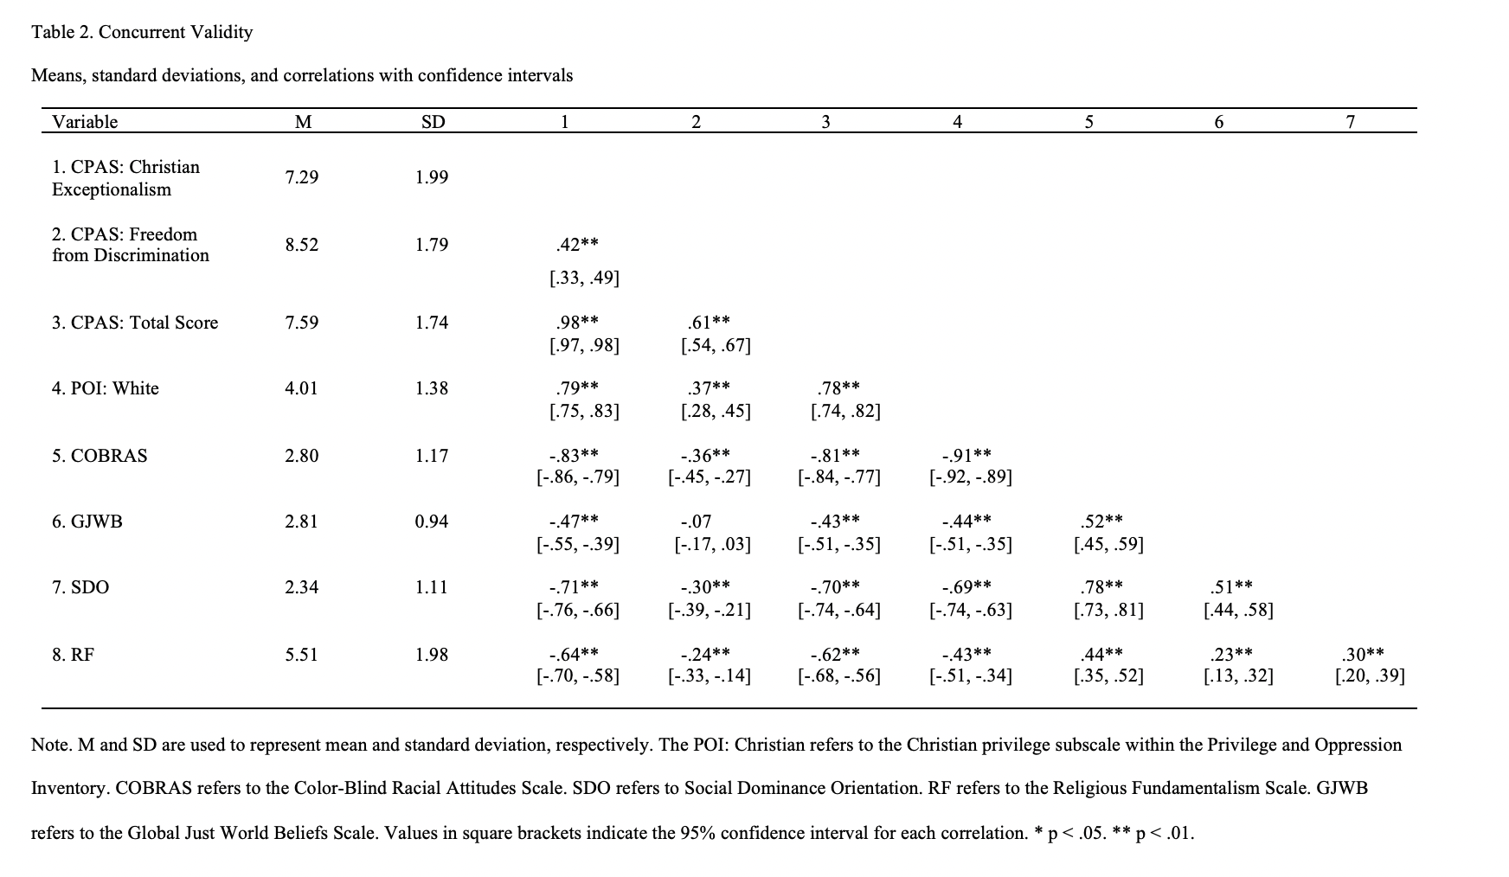

Slide 40
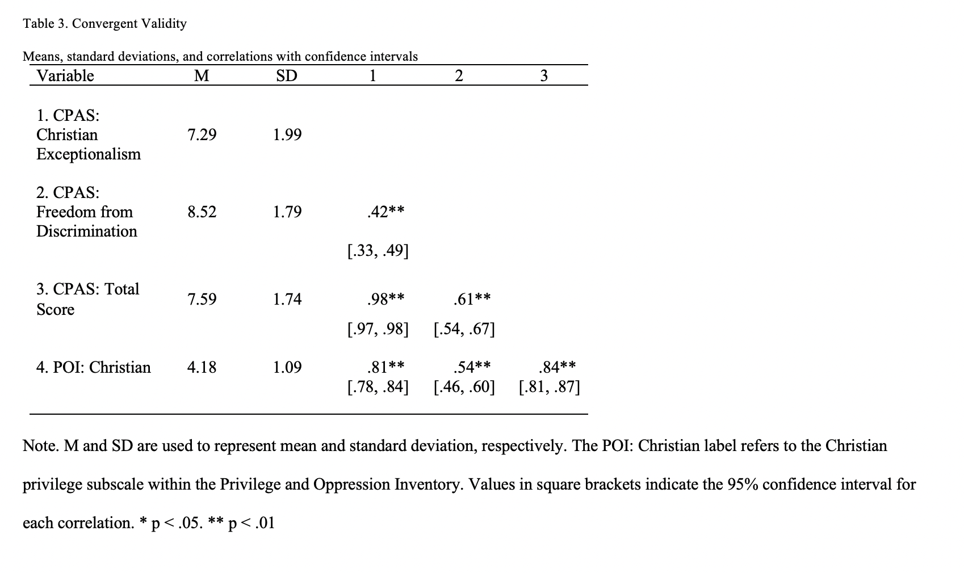

Slide 41
Discussion and Future Directions

Slide 42
General Thoughts
There are many scales to look at privilege related constructs (i.e., racism, sexism, White privilege, etc.)
These constructs influence human behavior and attitudes
While Christianity is pervasive and influential in the United States, there is relatively little research (i.e., Hays et al., 2007) that attempts to measure Christian privilege
This scale is one more attempt to extend the literature on this scarcely researched topic

Slide 43
Christian Exceptionalism Subscale
Taps themes related to advantages that Christians have in society (e.g., Christian symbols on government property)
Higher scores on Christian Exceptionalism correlate positively with White privilege and negatively with colorblind racial attitudes, social dominance orientation, and religious fundamentalism
The fact that the Christian Exceptionalism subscale correlates (r = .79) so strongly with the White privilege scale suggests they are measuring a similar construct; however, they are distinct as the white privilege scale (r = -.91) more strongly predicts color blind racial attitudes compared to the proposed subscale (r = -.83)
Importantly, the proposed subscale (r = -.64) more strongly predicts religious fundamentalism compared to the white privilege scale (r = -.43)

Slide 44
Christian Exceptionalism Subscale
However, the high correlation (r = .79) between the Christian Exceptionalism factor and White privilege isn’t necessarily unexpected as one might expect both constructs to have overlapping underpinnings (i.e., they’re branching manifestations of the broader concept of privilege)
Lastly, this subscale is positively correlated with the Christian privilege subscale (r = .81) in the Privilege and Oppression Inventory.
The latter finding indicates that the new scale demonstrates convergent validity

Slide 45
Freedom from Discrimination Subscale
Taps themes related to respondents’ awareness that they are not discriminated against because of their Christian beliefs (i.e., not having to worry about losing one’s job because they are Christian)
The subscale does show a moderately positive association (r = .42) with the Christian Exceptionalism subscale, suggesting that the two factors are still tapping a similar topic
This subscale mostly correlates in the same pattern directionally as the Christian Exceptionalism subscale.
The one exception is the Global Just World Beliefs scale

Slide 46
Why does Freedom From Discrimination Correlate with GJWB But Christian Exceptionalism Doesn’t?
It may suggest that being able to see oneself as free from being the target of discrimination is independent of privilege awareness
e.g., One may recognize one is not discriminated against, but fail to recognize either that one is privileged, or how others are discriminated against
May be worth adding additional items to this subscale to flesh this out (or dropping the factor if not)
E.g., “It should be okay for Christian organizations to deny employment to someone who isn’t Christian”

Slide 47
Interpretations
So why are Christian privilege and White privilege so strongly correlated?
1) Consistent with Faber (2012) theorizing
2) It’s also possible, however, that this is the result of bias in the sample (i.e., the sample was majority White and male)
Holding simultaneously advantaged identities may make one equally aware (or unaware) of multiple forms of privilege. This might cause various forms of privilege to appear highly correlated

Slide 48
Interpretations
How might we potentially tease this out?
One way to parse this would be to give this scale to both Black and White Christians to see if they differ on White privilege awareness while being similarly aware of Christian privilege.
However, even if White and Christian privilege are the same construct, this still opens up a world of research possibilities regarding the relationship between Christianity and White Supremacy.

Slide 49
Practical Uses
Outcomes of privilege and oppression are multifaceted interactions among and between identities
For example, the experiences of a Black atheist may differ from those of a White atheist as a result of the interaction between racial identity and religious affiliation
Intersectionality, or the idea that differential outcomes can result from complex interactions, may help us to understand differential outcomes
Society benefits (from an inclusion perspective) when people are aware of how privilege operates. This understanding reveals the myth of meritocracy

Slide 50
Multiculturalism In Real World Action
For those interested in issues of social justice and or diversity/inclusion this research is useful because:
High levels of multicultural competency have been shown to be correlated with White privilege awareness (Mindrup, 2011)
Additional research has shown that White privilege awareness in Christians are positively correlated with engagement in social justice (Todd, et al., 2015)

Slide 51
Why should people with privilege care?
Interestingly, White privilege awareness among White participants has been shown to be correlated with poorer mental health (potentially from guilt; Fujishiro, 2009).
This suggests that understanding (and eventually eliminating White privilege ) is even beneficial to White people
Elimination of guilt
Research shows those lower in White privilege awareness show less empathy with respect to racism (Spanierman & Heppner, 2004)
One could reasonably speculate these similar associations (and outcomes) could also apply to Christian privilege as well

Slide 52
Another Tool In The Toolbox
In this regard, while many tools exist to help society to better understand oppression resulting from race and gender, there are not many tools to examine oppression that results from religious affiliation.
The proposed scale (with its two subscales) provide one more tool that can allow educators in multiple disciplines to foster greater awareness of how Christians understand their religious identity and the privileges that come along with it

Slide 53
Limitations
Convenience sample that may limit the generalizability of these findings
This sample was developed only for Christian participants. More work will be needed to see if some modification of this measure would work for other religious groups as well

Slide 54
Future Directions
Further studies need to confirm this factor structure applies not only outside this sample, but across denominations and race
Further studies should assess how this Christian privilege scale relates to other measures of Christian identity and religiosity (e.g., QUEST scale, Intrinsic and Extrinsic religiosity)
Further research will also wish to investigate how sensitive the scale is to change within individuals
Such a step is necessary before this instrument could be used in an applied setting or within diversity training programs

Slide 55
Final Thoughts
Overall, this scale provides an initial promising start to assess Christian’s awareness of their own privilege by building on the work of Schlosser (2003) and Hays, et al. (2007) while adding another tool to the toolbox for measuring Christian privilege as is common for White privilege measurement (i.e., Color-Blind Racial Attitudes Scale, White Privilege Attitudes Scale, Privilege and Oppression Inventory, etc.)

Slide 56
Q&A Session

